Slide 1
DNN Modules Re-Thought
By: Taylor Brazelton

Slide 2
Tools
VS Community 2013
w/ your favorite JS Linter
DNN Module Templates
Google Chrome Developer Tools
Self Hosted DNN Instance
https://christoctemplate.codeplex.com
Or via Package Manager

Slide 3
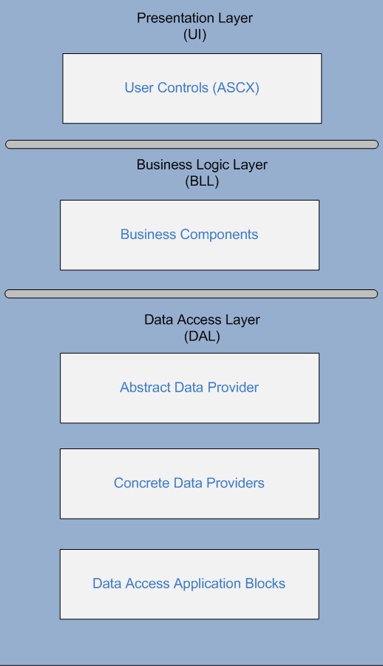
DNN Way:
Tier 1:
ASP.NET/HTML
Tier 2:
C#.NET
Tier 3:
C# & PETA POCO

Slide 4
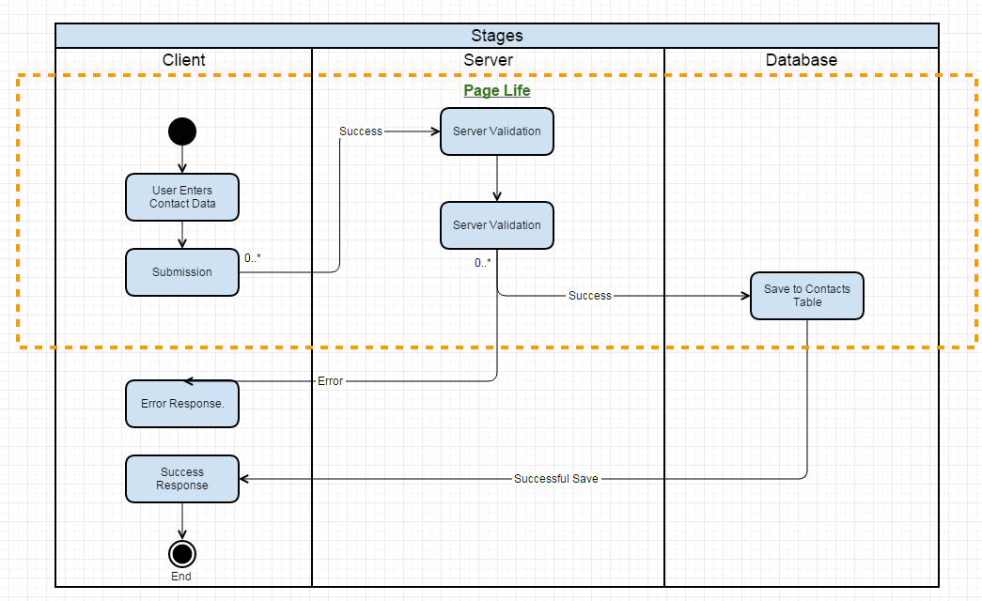
UX
Save Data

Slide 5
Issues
Full Page Refreshes
Annoying for your clients
Long Page Load Times
Loss In The Users Productivity
Bootstrap UI
Version can break your UI
Documentation
LOL. What are you talking about?
Multi Step Modules
Page Refreshes
Use Our ORM!
Can’t Do Simple Joins
Annoying
Outdated
It is good at being an SQL gateway…

Slide 6
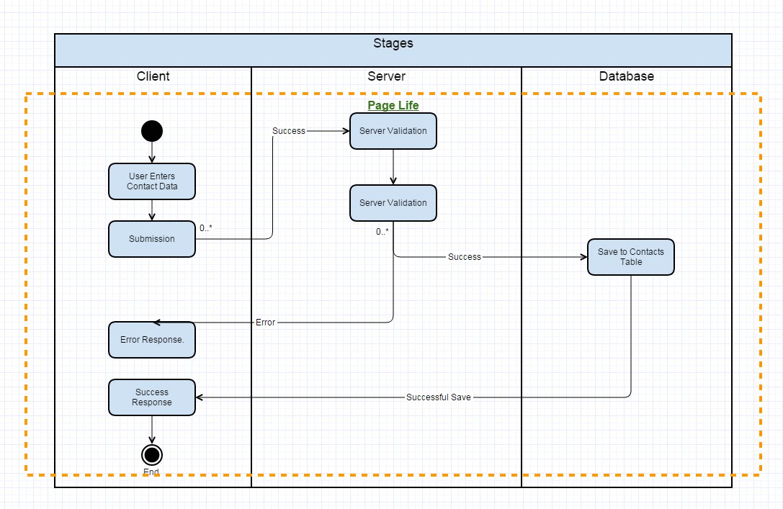
MC-MVC Way:

Slide 7
Tech Stack
UI – Skeleton CSS w/ Normalize
Client Binding – Knockout.JS & jQuery
API – DNN extended Web API
Controllers – C#
DB Interactions – SQL
http://getskeleton.com/
http://knockoutjs.com/
http://bit.ly/1KB57jD
http://asp.net
http://bit.ly/1LT0XCl

Slide 8
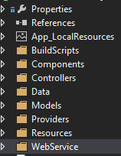
Setup
Controllers
BLL
Models
Data Representation as Objects
Resources
CSS, JS, and Images go here
Web Service
Contains the API controllers/endpoints

Slide 9
Demo Setting Up A Project

Slide 10
Globals
ModuleId
TabId
TabModuleId
UserId
Etc.

Slide 11
Settings
Settings.ascx
Settings Object:
PortalModuleBase.Settings
Settings Module Demo

Slide 12
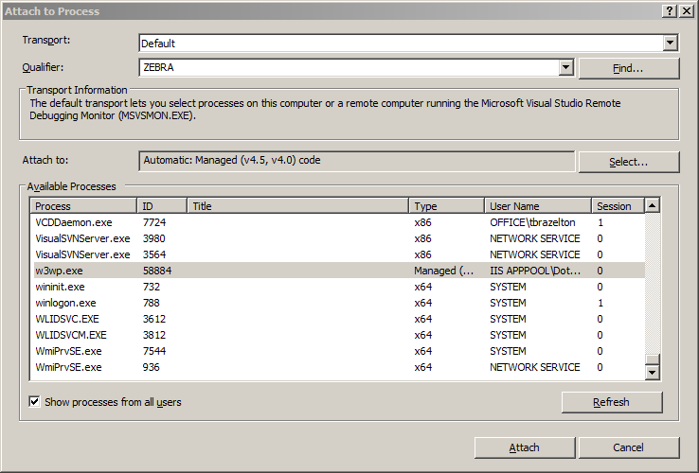
Debugging
Set Breakpoint
CTRL + ALT + P
Press W
Select w3wp.exe
Attach

Slide 13


Banana For Scale

Slide 14
Sources:
Setup: http://tech-fyi.net/2015/07/22/dotnetnuke-modules-layoutdesign/
State Diagrams Via: Gliffy.com

